Slide 1
Lending Case Study
Group Members:
Susmita Mishra
Puneet Upadhyay

Slide 2
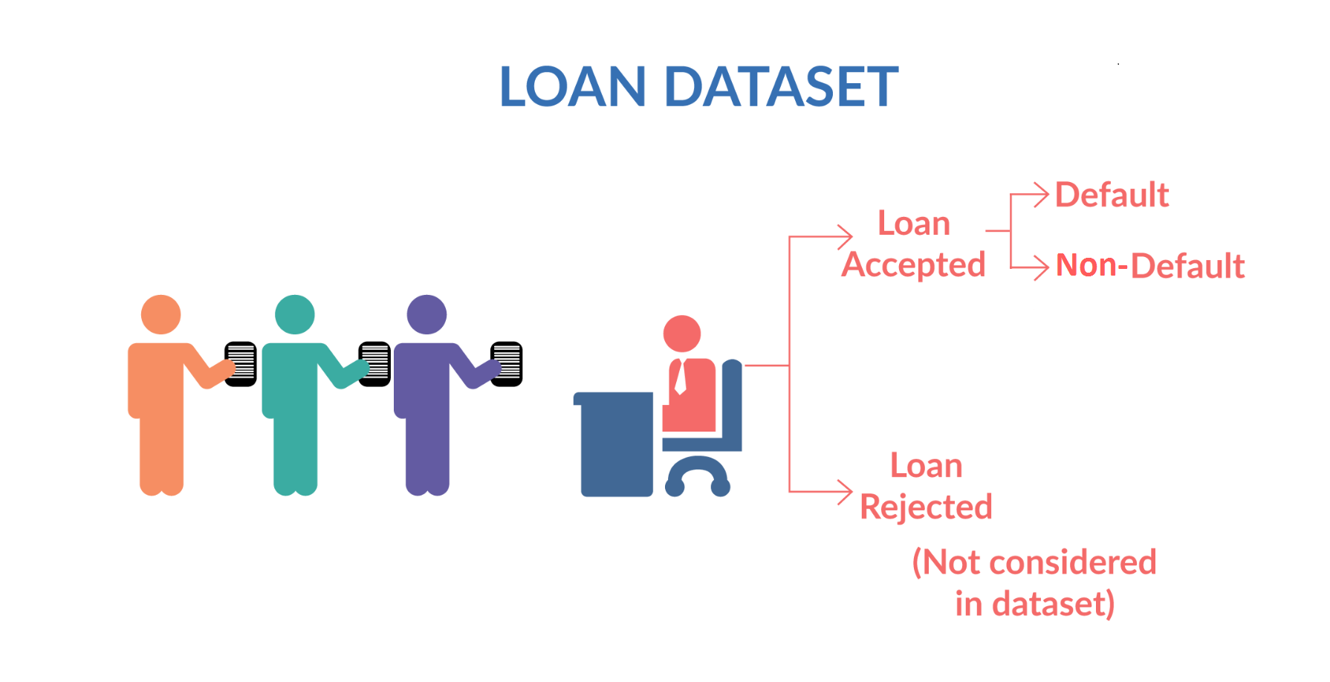
Business Understanding
To make a decision for a consumer finance company for loan approval based on the applicant’s profile. Two types of risks are associated with the bank’s decision:
If the applicant is likely to repay the loan, then not approving the loan results in a loss of business to the company
If the applicant is not likely to repay the loan, i.e. he/she is likely to default, then approving the loan may lead to a financial loss for the company

Slide 3
Objective
To understand the driving factors (or driver variables) behind loan default, i.e. the variables which are strong indicators of default.
To perform EDA to analyse how consumer attributes and loan attributes influence the tendency of default..
To identify the risky loan applicants, then such loans can be reduced thereby cutting down the amount of credit loss.
The objective is to pinpoint applicants at risk of defaulting on loans, enabling a reduction in credit losses. This case study aims to achieve this goal through exploratory data analysis (EDA) using the provided dataset.
In essence, the company wants to understand the driving factors (or driver variables) behind loan default, i.e. the variables which are strong indicators of default. The company can utilise this knowledge for its portfolio and risk assessment.

Slide 4
Data Understanding
1. Primary Attribute : Loan Status:
Fully paid: Applicant has fully paid the loan (the principal and the interest rate)
Current: Applicant is in the process of paying the instalments, i.e. the tenure of the loan is not yet completed. These candidates are not labelled as 'defaulted'.
Charged-off: Applicant has not paid the instalments in due time for a long period of time, i.e. he/she has defaulted on the loan
2. Customer Demographics Key Columns:
Annual Income (annual_inc): Reflects the customer's annual income. Typically, a higher income enhances the likelihood of loan approval.
Home Ownership (home_ownership): Indicates whether the customer owns a home or rents. Home ownership provides collateral, thereby increasing the probability of loan approval.
Employment Length (emp_length): Represents the customer's overall employment tenure. Longer tenures signify greater financial stability, leading to higher chances of loan approval.
Debt to Income (dti): Measures how much of a person's monthly income is already being used to pay off their debts. A lower DTI translates to a higher chance of loan approval.
State (addr_state): Denotes the customer's location and can be utilized for creating a generalized demographic analysis. It may reveal demographic trends related to delinquency or default rates.

Slide 5
3. Loan Characteristics Key Columns:
Loan Amount (loan_amt): Represents the amount of money requested by the borrower as a loan.
Grade (grade): Represents a rating assigned to the borrower based on their creditworthiness, indicating the level of risk associated with the loan.
Term (term): Duration of the loan, typically expressed in months.
Loan Date (issue_d): Date when the loan was issued or approved by the lender.
Purpose of Loan (purpose): Indicates the reason for which the borrower is seeking the loan, such as debt consolidation, home improvement, or other purposes.
Verification Status (verification_status): Represents whether the borrower's income and other information have been verified by the lender.
Interest Rate (int_rate): Represents the annual rate at which the borrower will be charged interest on the loan amount.
Public Records Bankruptcy (public_rec_bankruptcy): Indicates the number of locally available bankruptcy records for the customer. A higher value in this column is associated with a lower success rate for loan approval.

Slide 6
Exploratory Data Analysis
1. Data sourcing
2. Data cleaning
3. Univariate analysis
4. Bivariate analysis
5. Derived metrics
Data Cleaning
Importing the Data
Removing large null value columns
Removing irrelevant columns
Removing/Fixing null values
Correcting data types and deriving new columns
Filter Data for requirement.
Removing Duplicate Data
Removing outliers

Slide 7
1. Filter Data :
a. Removing Irrelevant Columns:
Customer Behaviour Columns - Columns that describe customer behaviour will not be factored into our analysis. The current analysis focuses on the loan application stage, while customer behaviour variables pertain to post-approval actions. Consequently, these attributes will not influence the loan approval/rejection process.
Granular Data - Columns providing highly detailed information that may not be necessary for our analysis will be omitted.
Descriptive Columns – Columns that contains just descriptive text (nouns), redundant column, index variables that do not contribute to the analysis.
b. Removing Irrelevant Rows: Rows with a "loan_status" of "Current" will be dropped as they represent loans in progress and do not contribute to loan approval decisions.
2. Treating Nulls and Duplicates
Certain columns contain only null values, and these columns will also be dropped.
9 Columns with single value that do not contribute to the analysis will be removed.
Columns with more than 50% of data being empty will be dropped.
3. Fix missing values 4. Correcting Datatypes 5. Standardizing Values 6. Outlier Treatment 7. Deriving New Columns

Slide 8
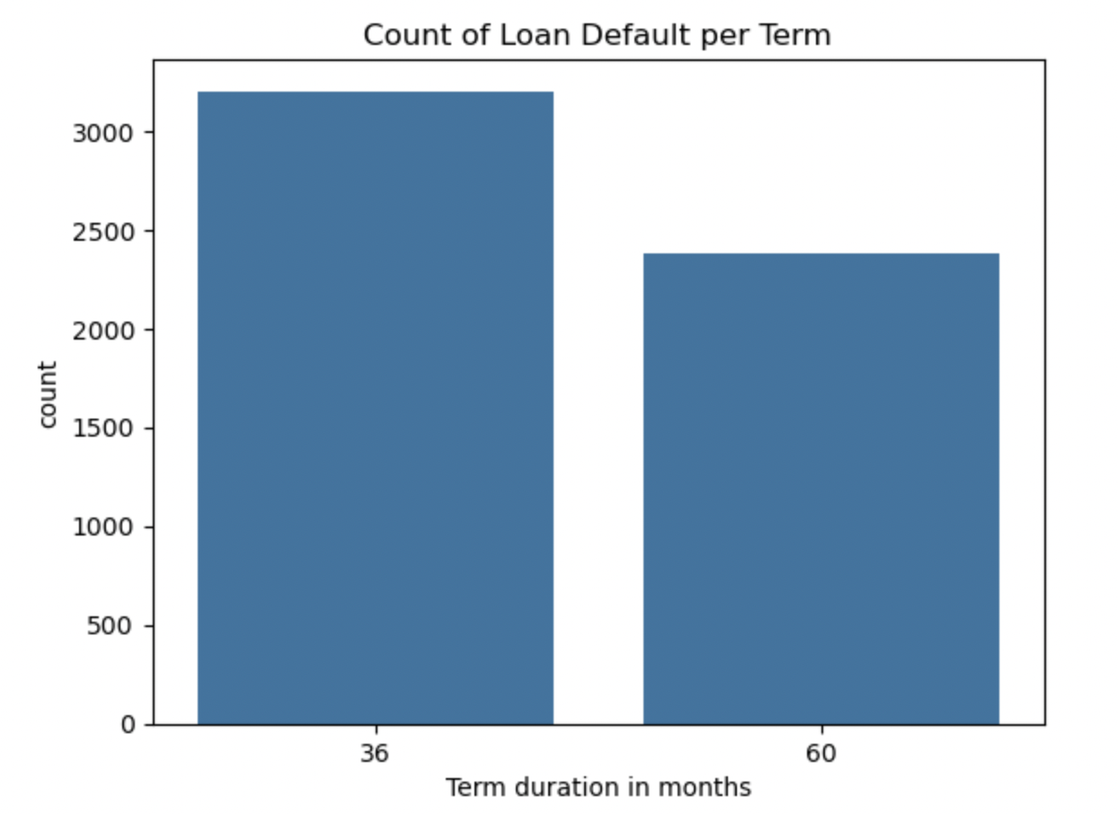
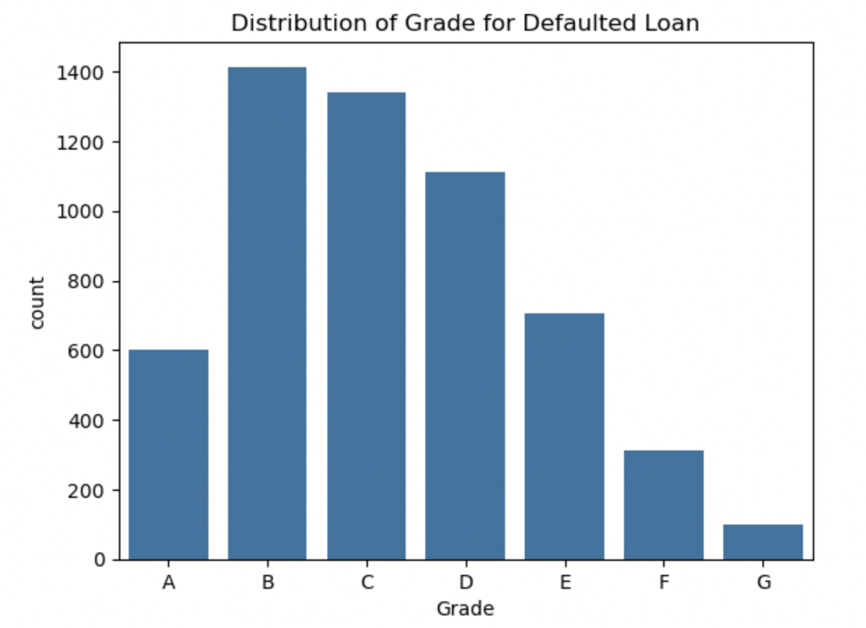
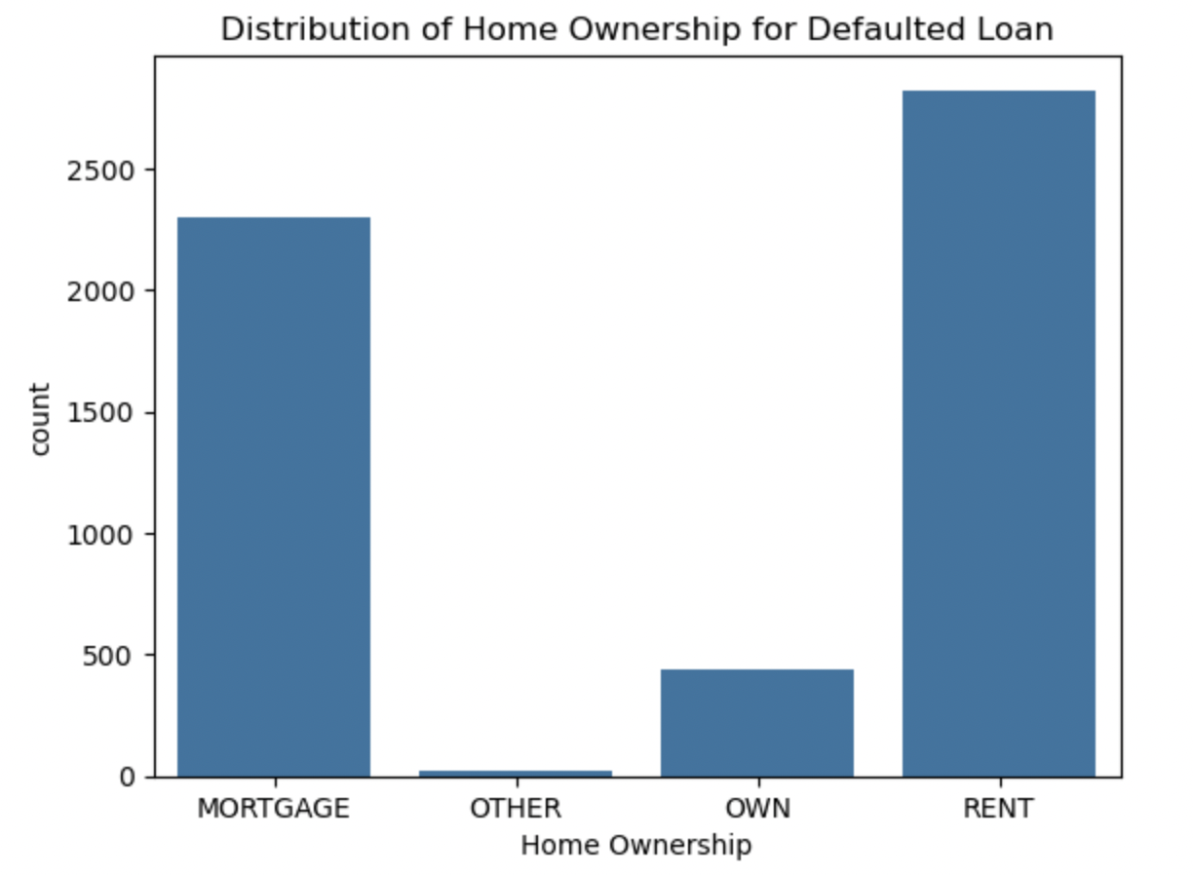
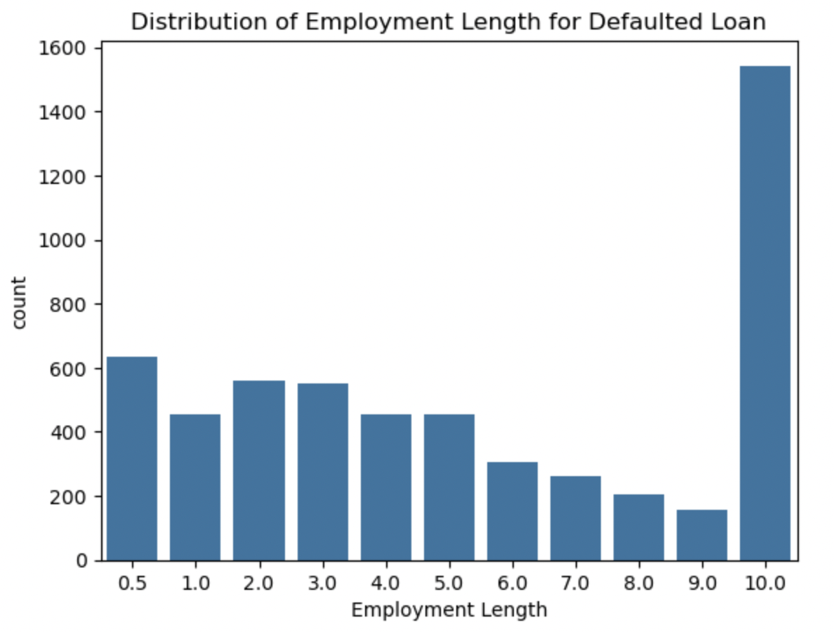
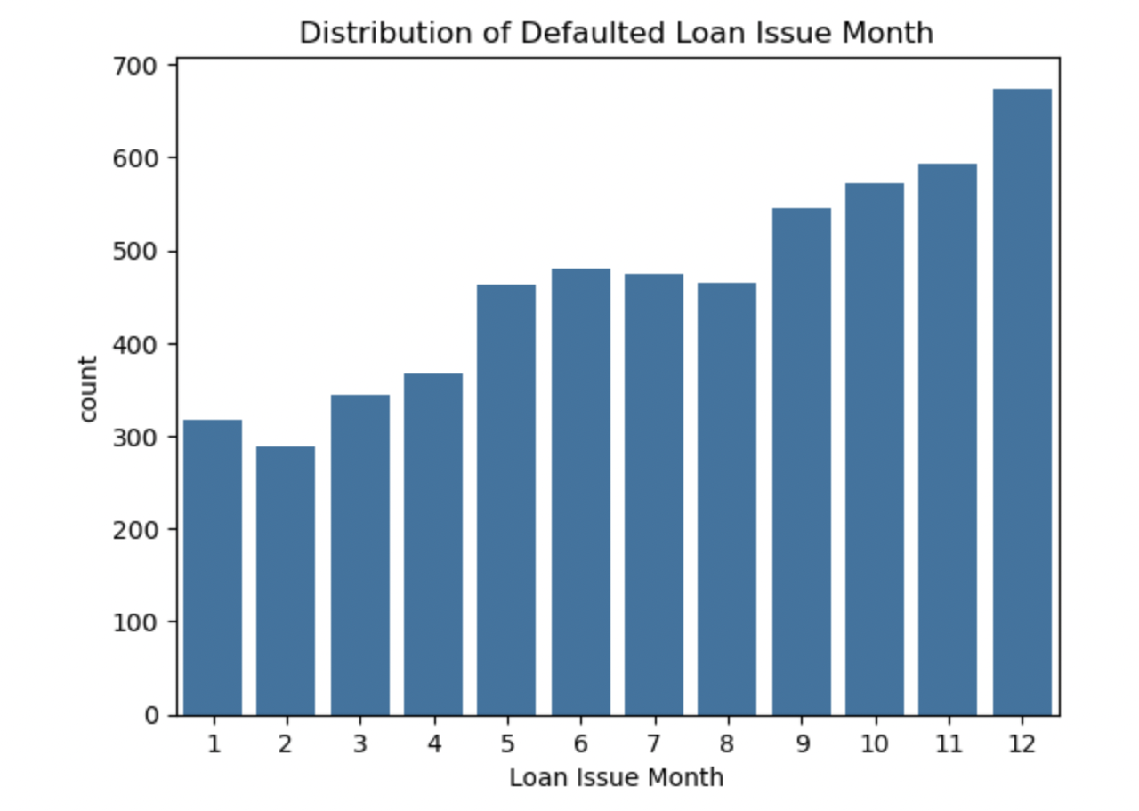
Univariate Analysis – Categorical columns

Slide 9
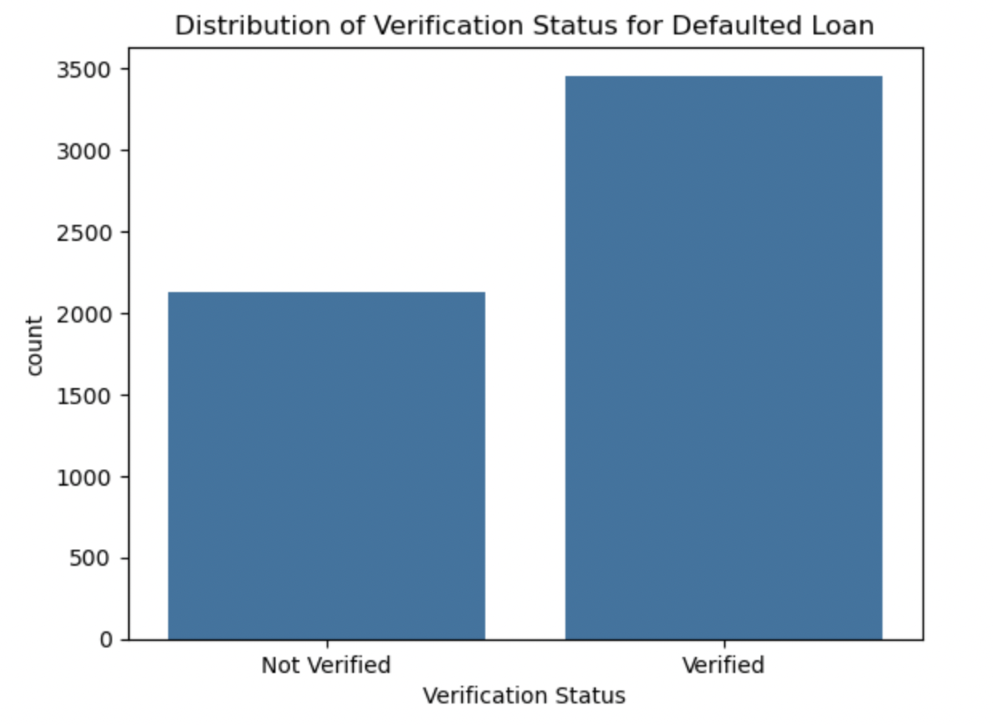
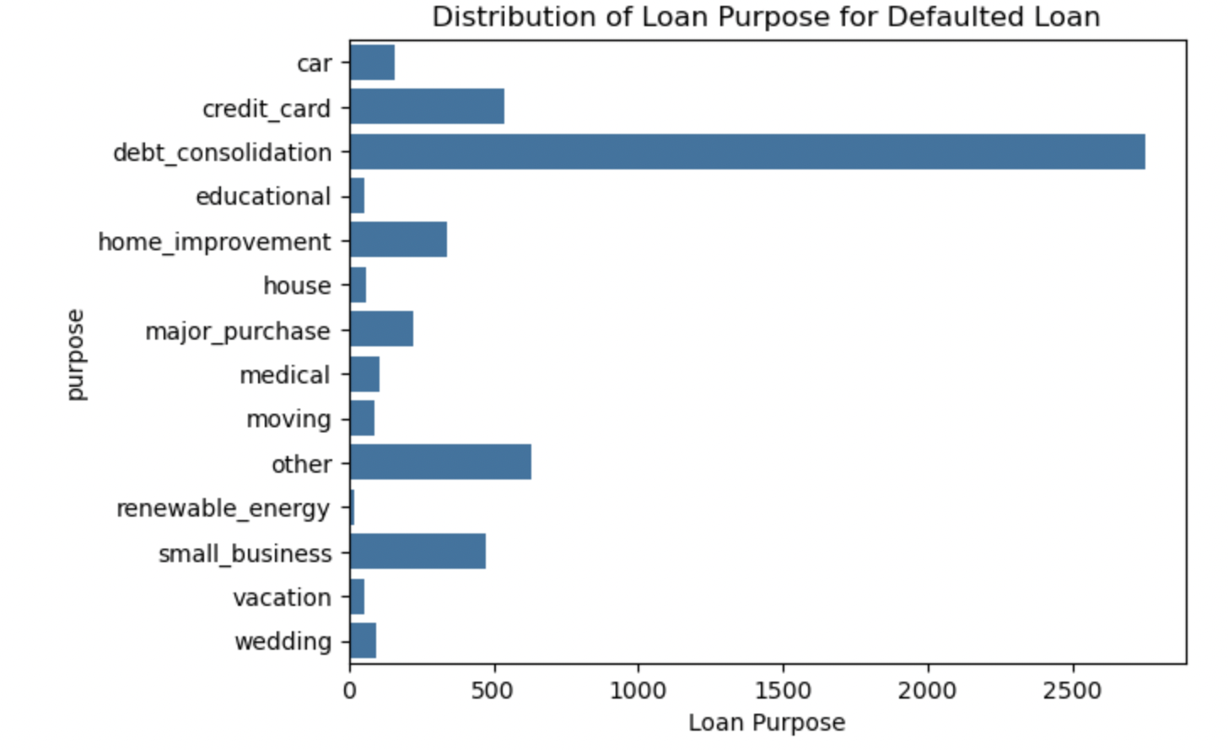
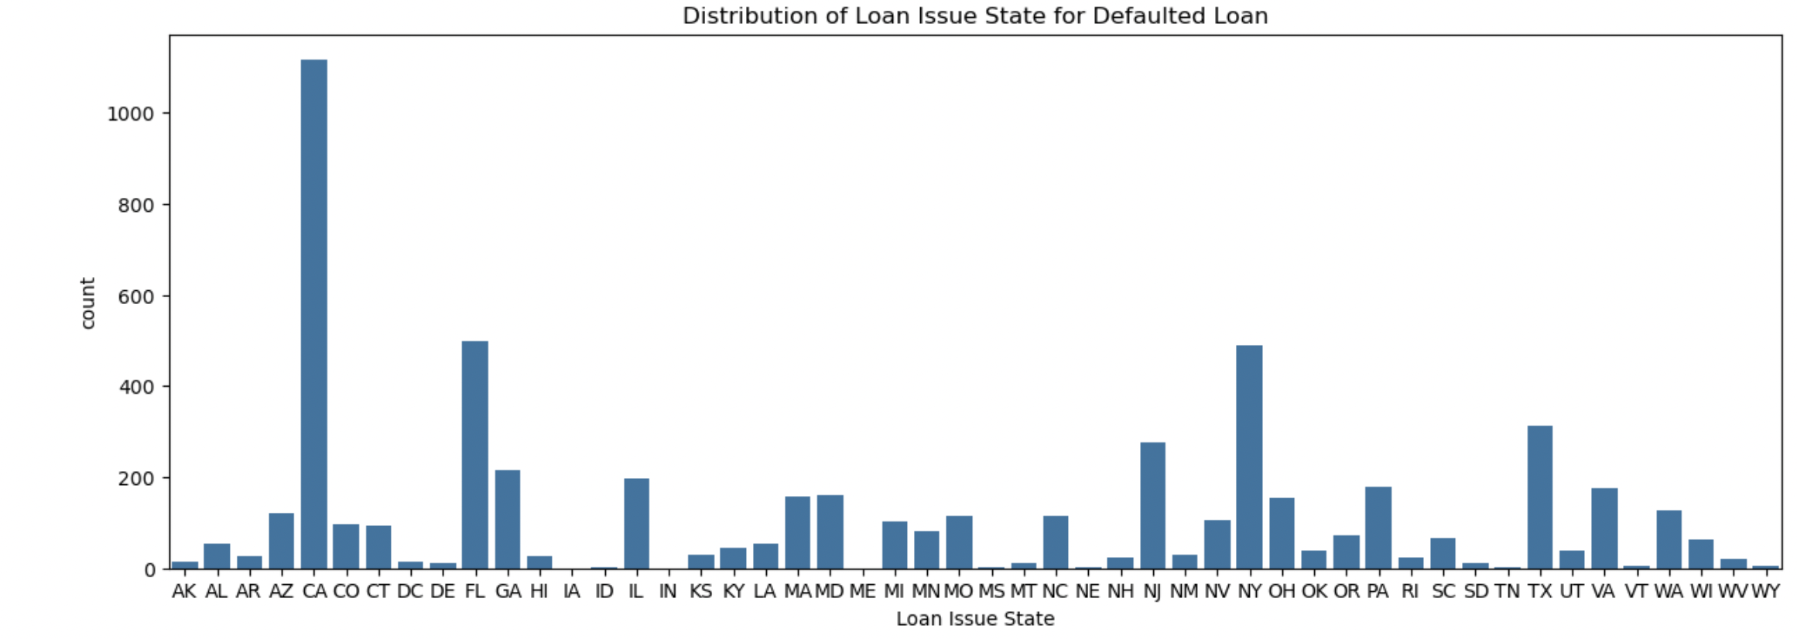
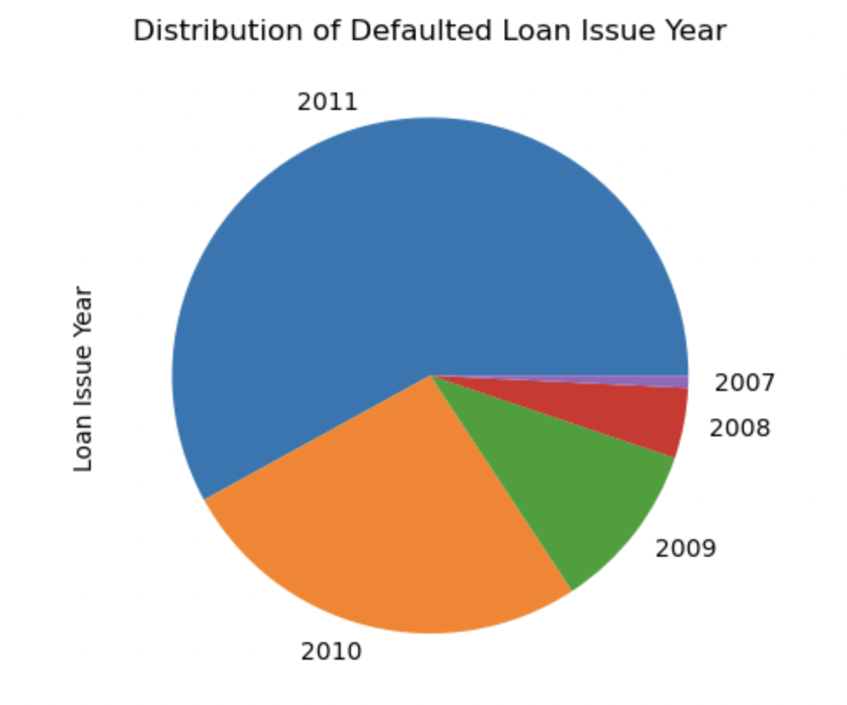

Slide 10
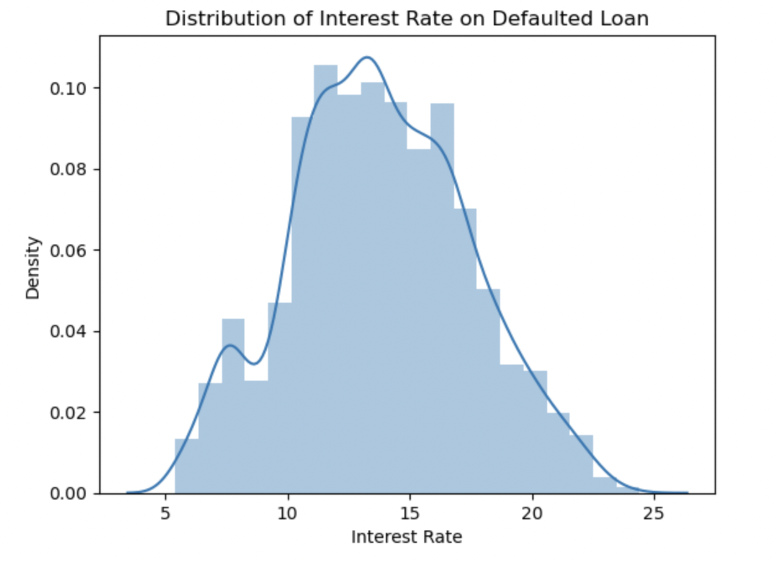
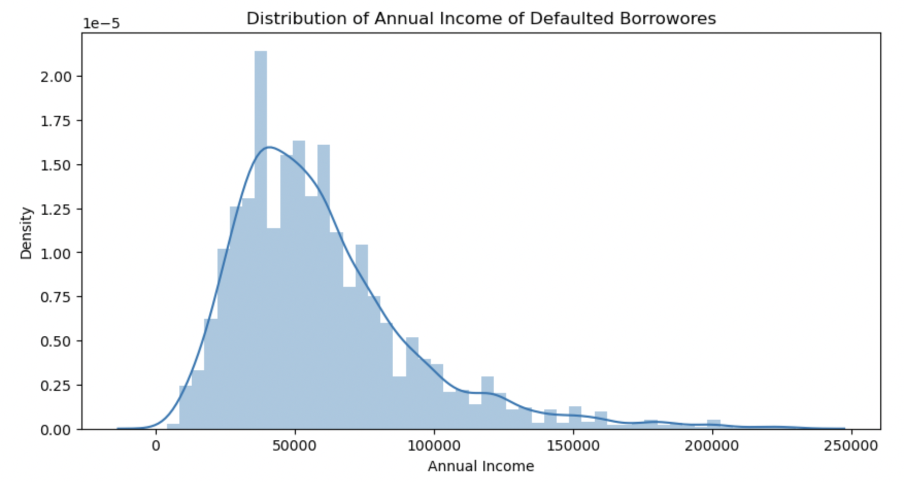
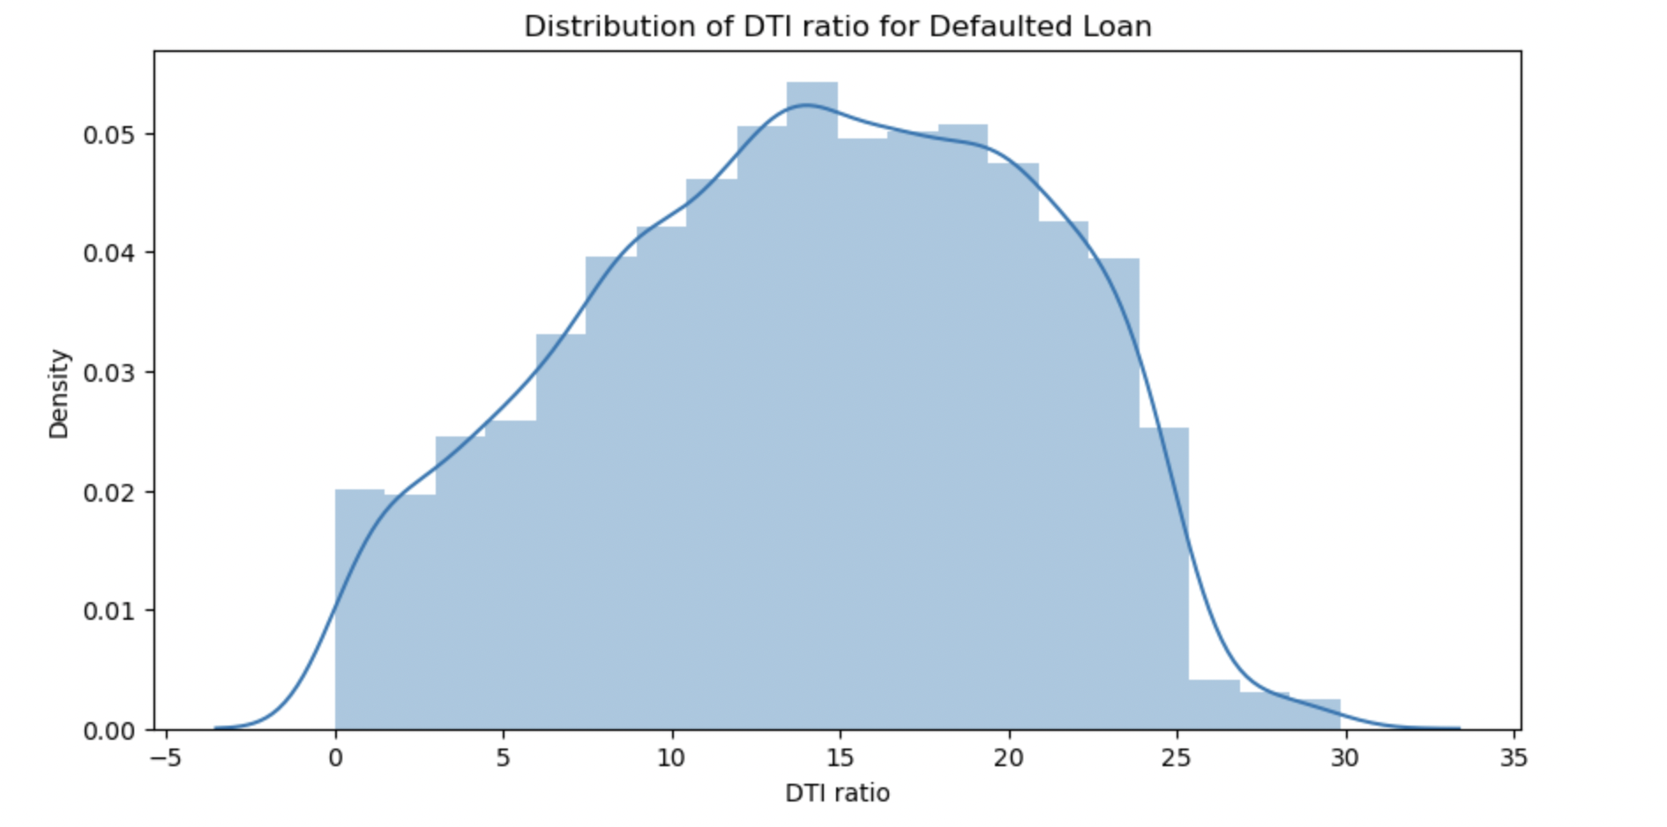
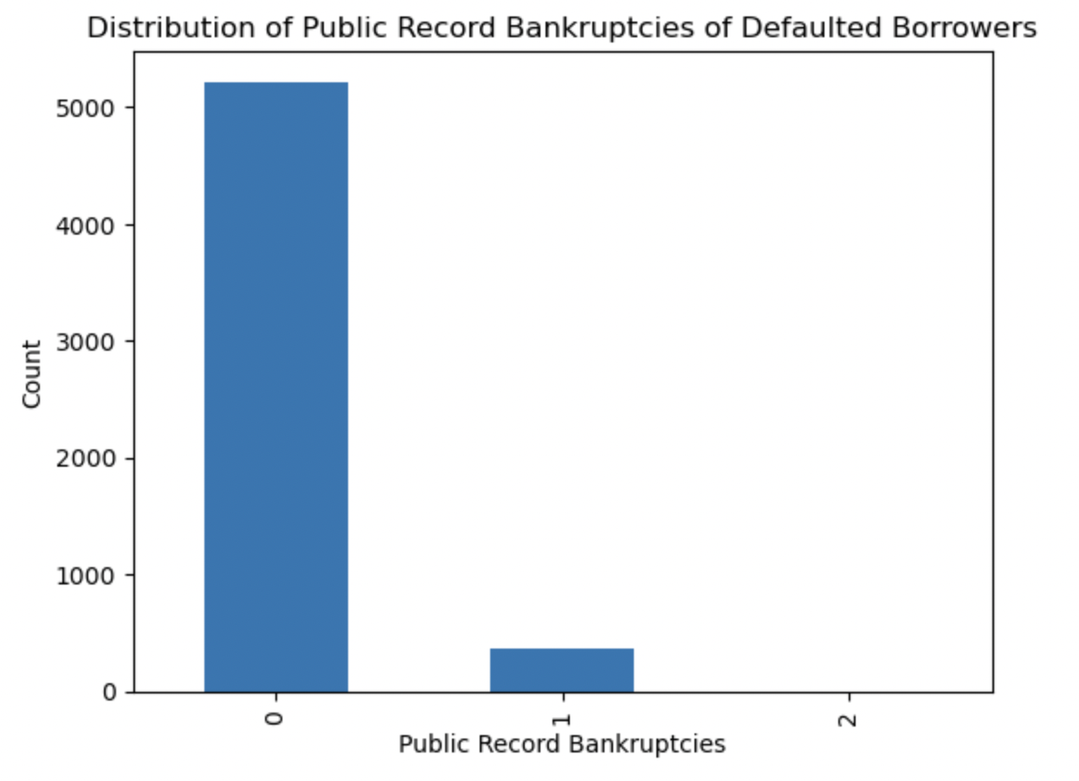
Univariate Analysis – Quantitative Columns

Slide 11
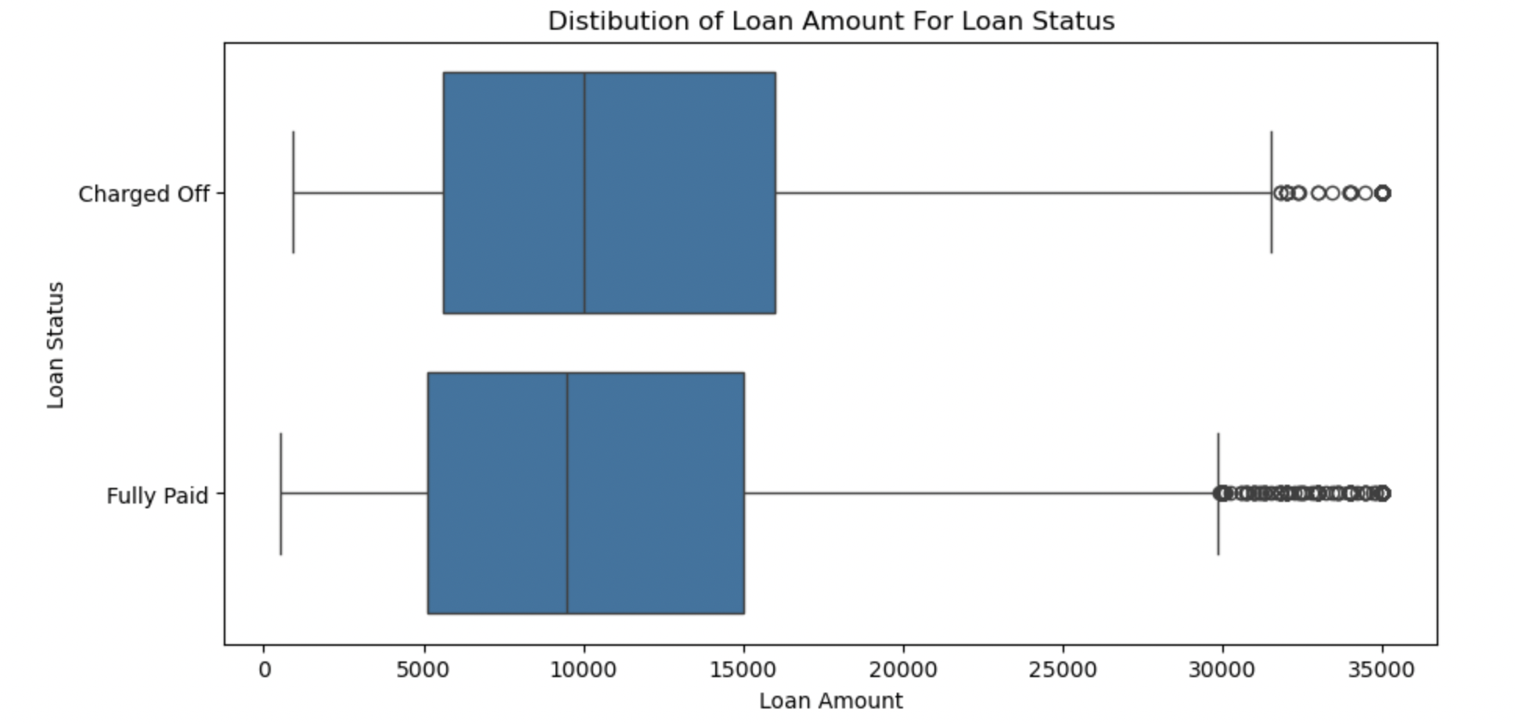
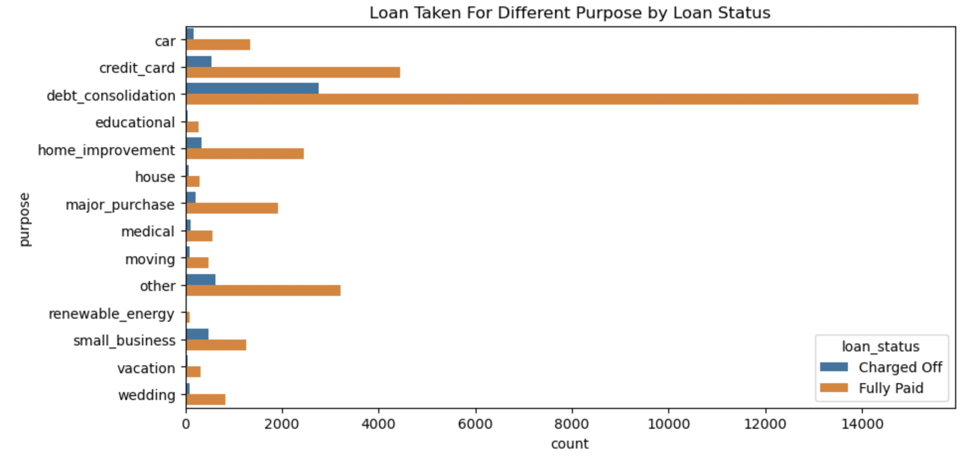
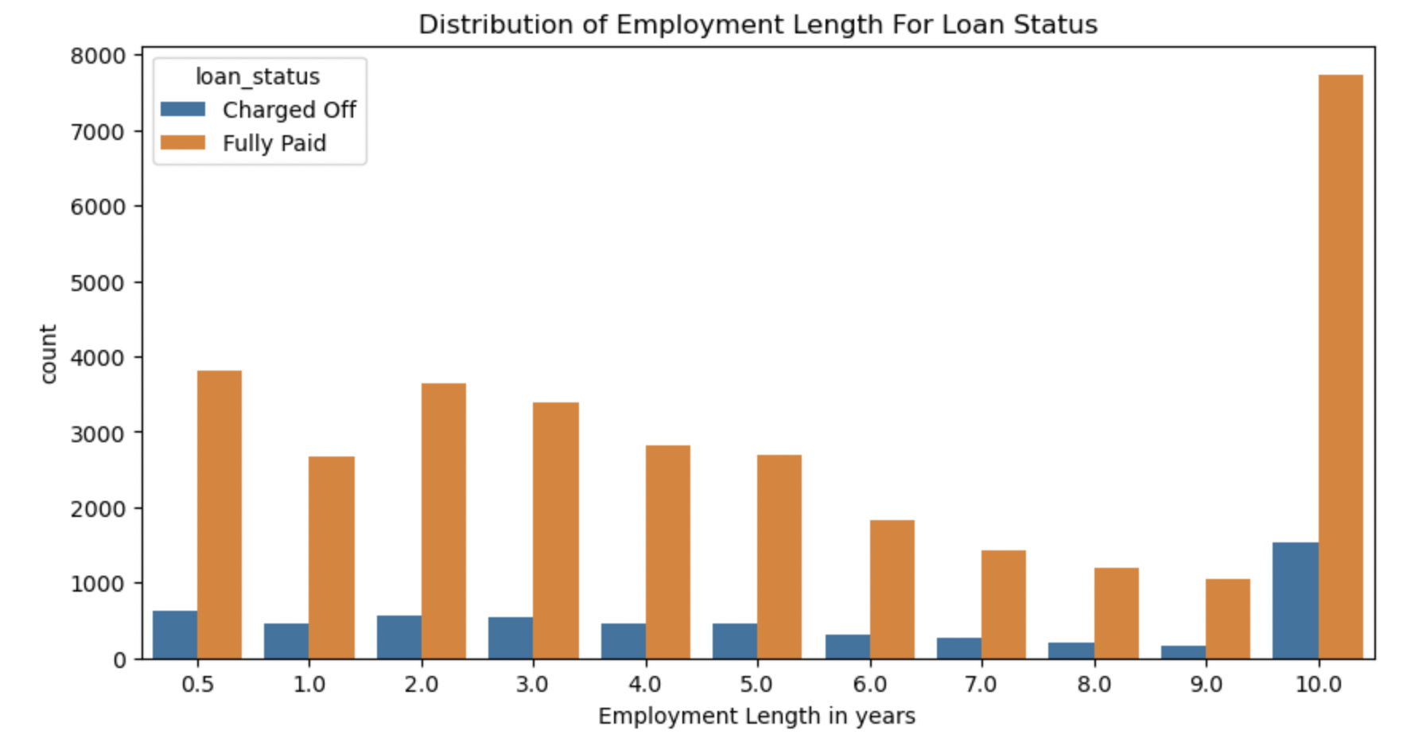
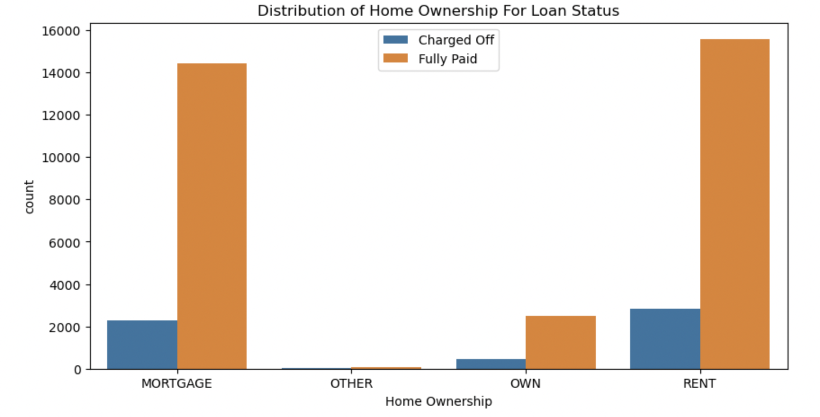
Univariate Segmented Analysis

Slide 12
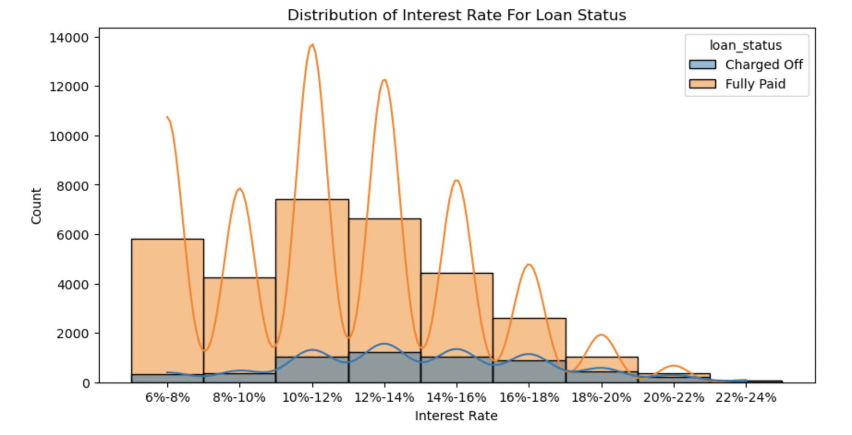
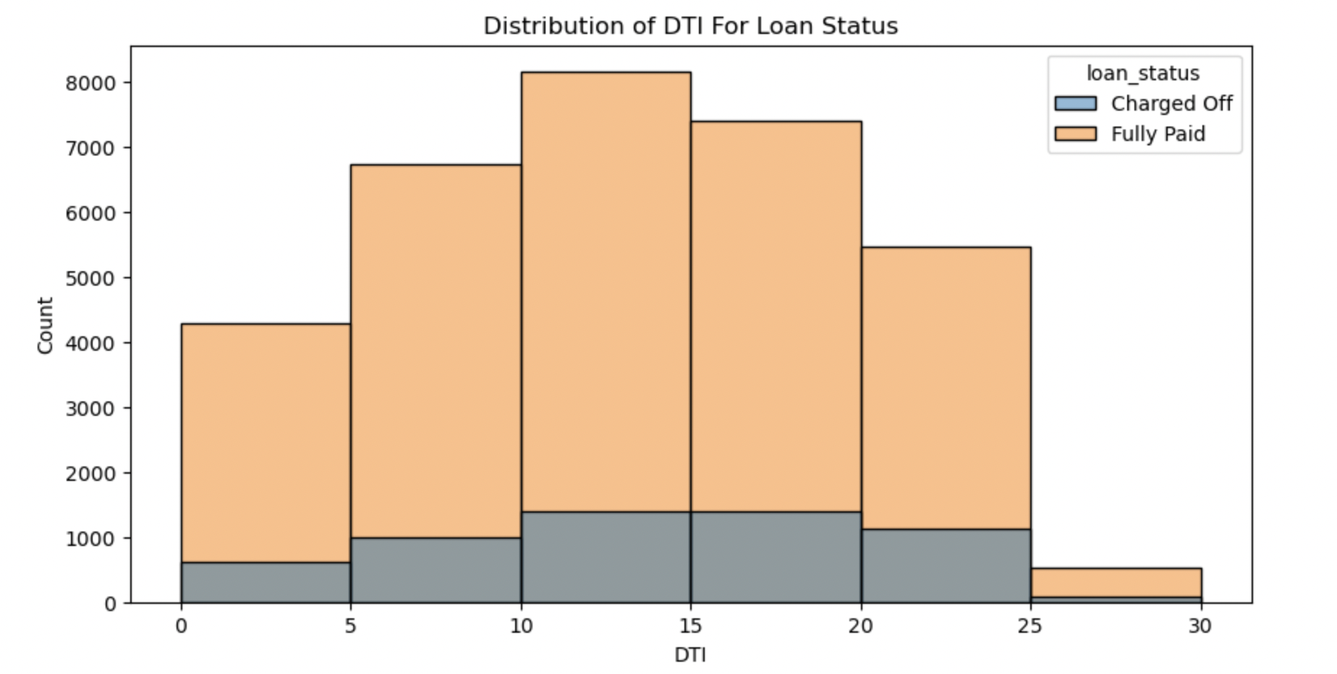
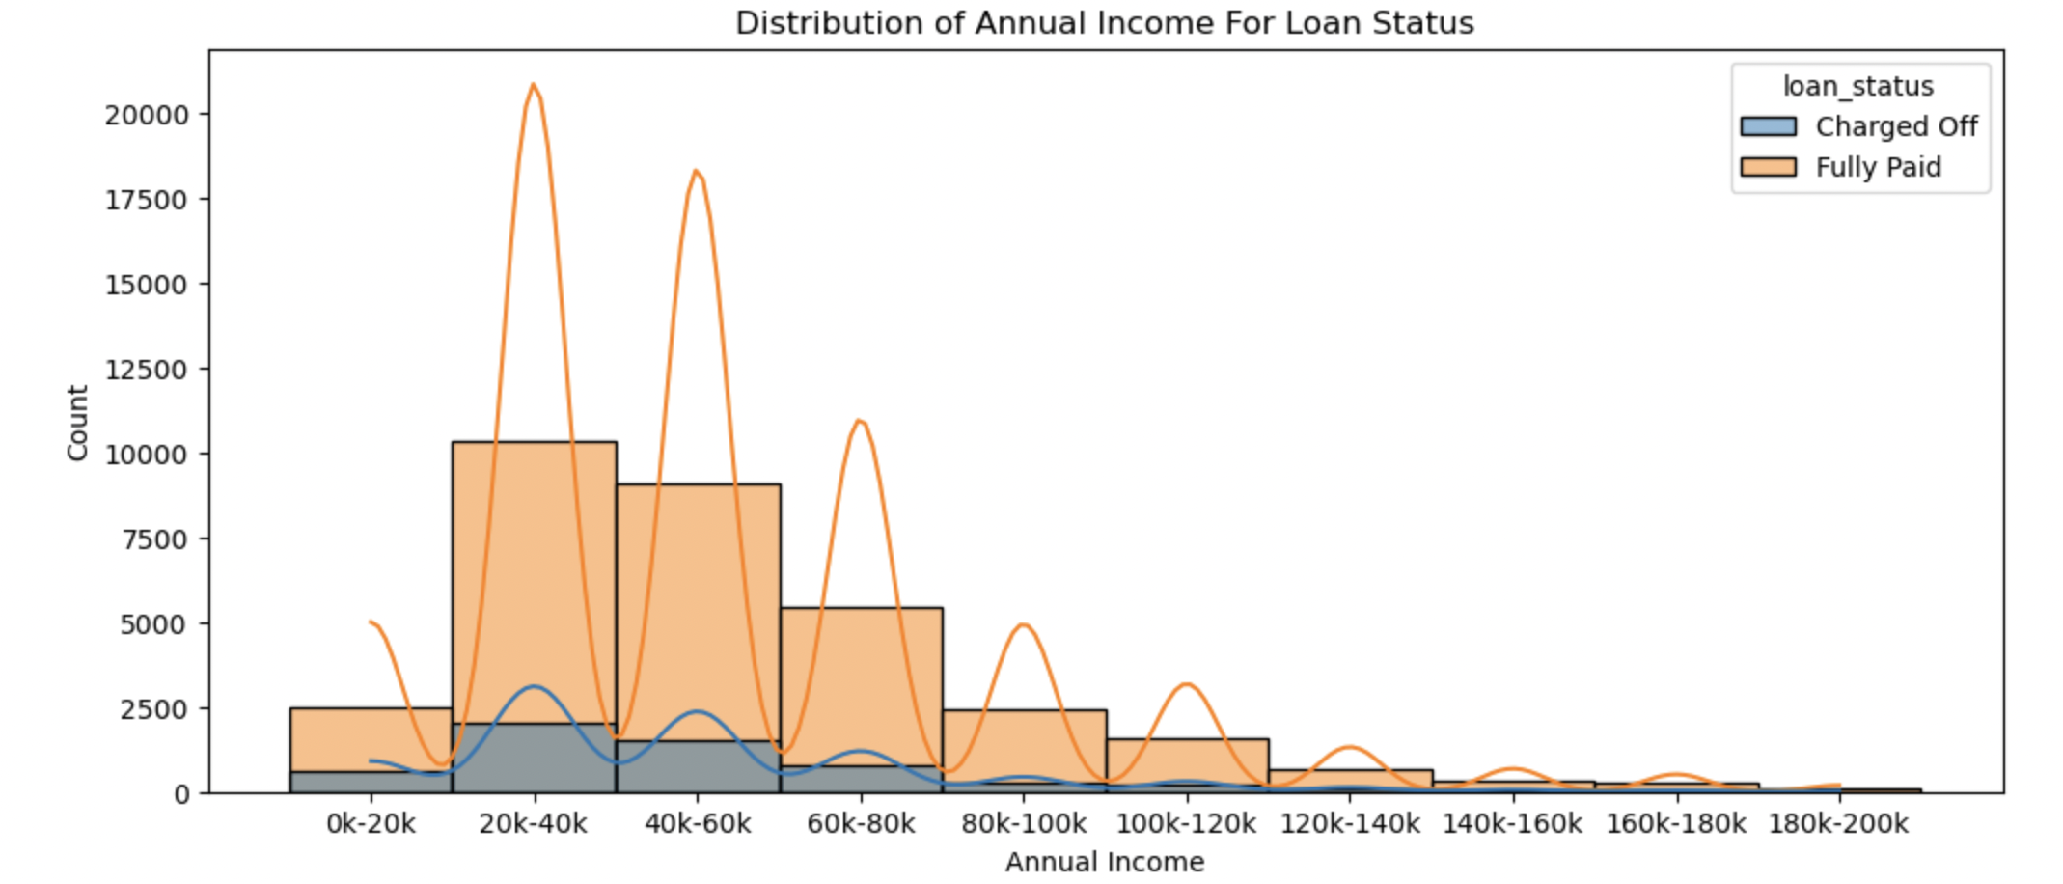
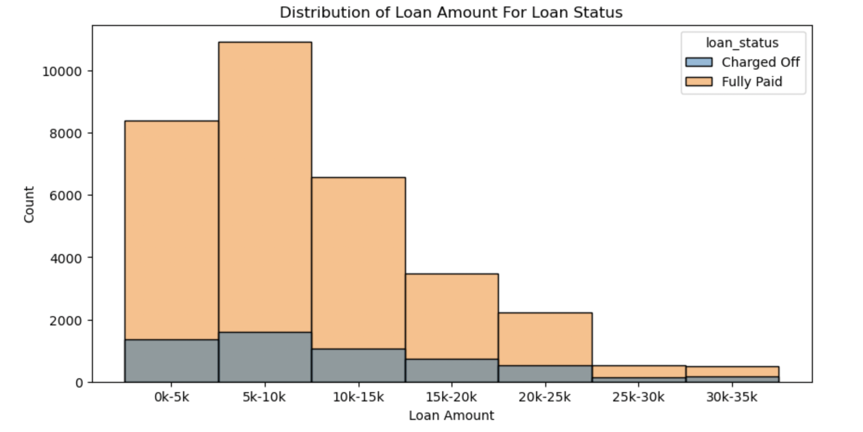

Slide 13
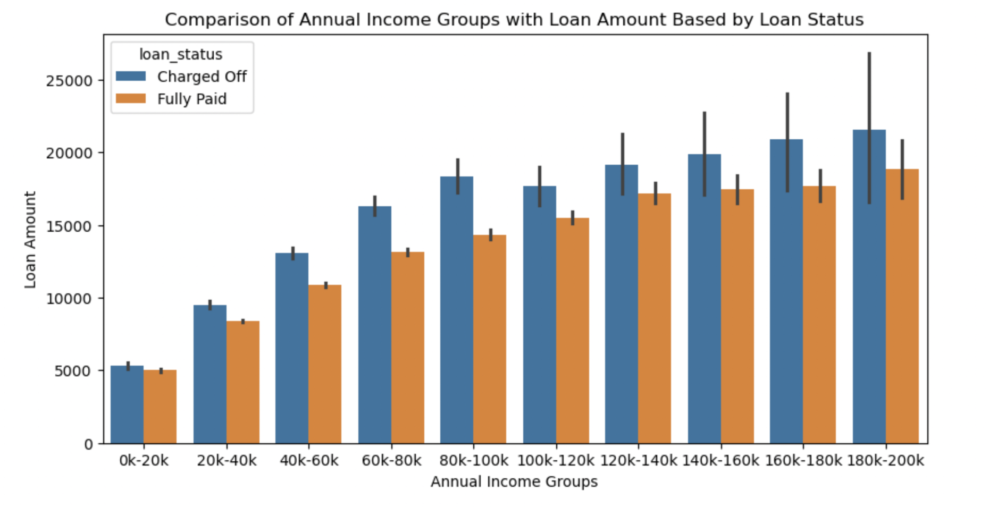
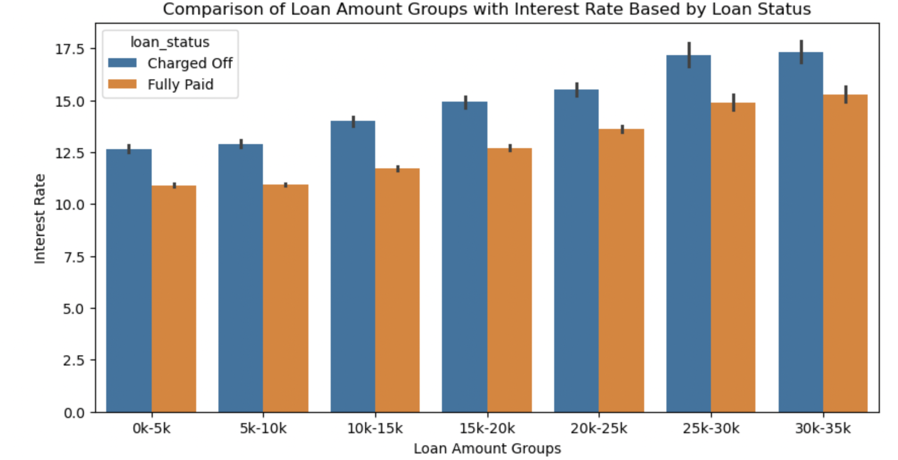
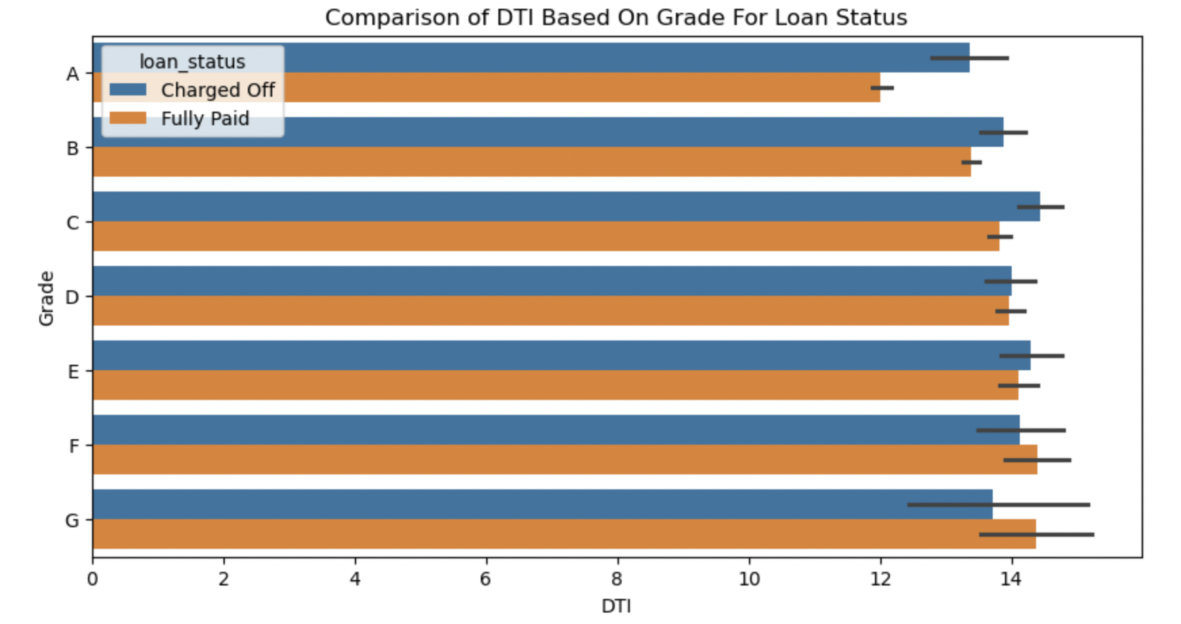
Bivariate Analysis

Slide 14
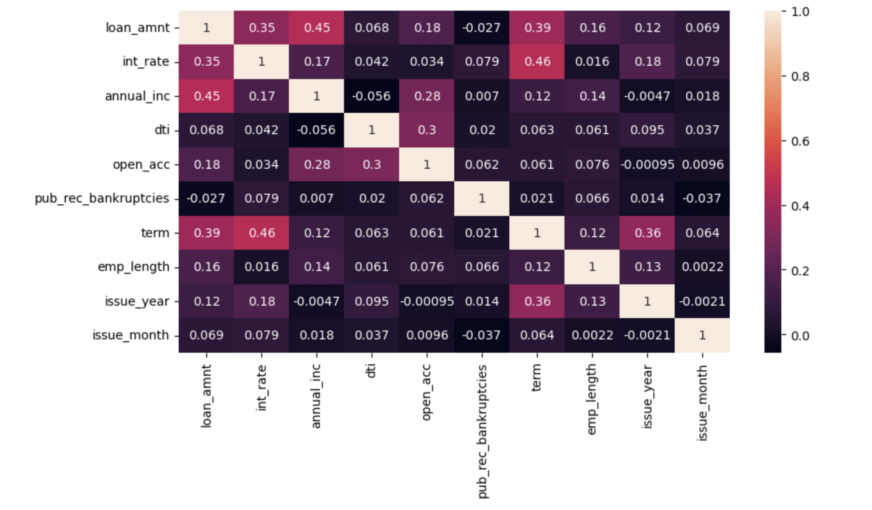
Multivariate Analysis- Correlation Matrix

Slide 15
Observations and Inferences from Univariate Analysis
Univariate Analysis
The number of defaulted loan(5k) is 7 times less than the number of fully paid loan(35k).
The majority(almost 3 times) of loan has a term of 36 months compared to 60 months.
A large amount of loans are with grade 'B' commpared to rest showing most loans are high grade loans.
Majority of borrowsers have working experience greater than 10 years.
Majority of borrowsers don't posses property and are on mortage or rent.
About 50% of the borrowers are not verified by company or source.
Annual Income shows left skewed normal distribution thus we can say that the majority of burrowers have very low annual income compared to rest.
The interest rate is more crowded around 10-15.
A large percentage of loans are taken for debt consolidation followed by credit card purpose.
Majority of the borrowers are from the large urban cities like california, new york, texas, florida etc.
Majority of the borrowers have very large debt compared to the income registerd, concentrated in the 10-15 DTI ratio.
Majority of the borrowers have no record of Public Recorded Bankruptcy.
Majority of the loans are given in last quarter of the year.
The number of loans approved increases with the time at expontential rate, thus we can say that the loan approval rate is increasing with the time.

Slide 16
Segmented Univariate Analysis
Debt Consolidation is the most popular loan purpose and has highest number of defaulted loan.
The mean and 25% are same for both but we see larger 75% in the defaulted loan which indicate loan of large amount has higher chance of defaulting.
The 36 month term has higher chance of defaulting than 60 month term.
The Loan Status varies with DTI ratio, we can see that the loans in DTI ratio 10-15 have higher number of defaulted loan but higher dti has higher chance of defaulting.
The Defaulted loan are lower for the burrowers which own their property compared to on mortgage or rent.
Burrowers with less 50000 annual income are more likely to default and higher annual income are less likely to default.
The Fully paid loan are increasing exponentially with the time compared to defaulted loan.
The default loan amount increases with interest rate and shows are decline after 17.5 % interest rate.
The Employees with 10+ years of experience are likely to default and have higher chance of fully paying the loan.
Bivariate Analysis
The loan applicants belonging to Grades B, C, and D contribute to most of the "Charged Off" loans.
Loan applicants applying for loans with a 36-month term are more likely to default than those taking loans for 60 months.
Most loan applicants have ten or more years of experience, and they are also the most likely to default.
The number of loan applicants has steadily increased from 2007 to 2011, indicating a positive trend in the upcoming years.
December is the most preferred month for taking loans, possibly due to the holiday season.
Debt consolidation is the category where the maximum number of loans are issued, and people have defaulted the most in the same category.
Loan applicants who live in rented or mortgaged houses are more likely to default.
Verified loan applicants are defaulting more than those who are not verified.
Loan applicants from the states of California (CA), Florida (FL), and New York (NY) are most likely to default.
A majority of the loan applicants who defaulted received loan amounts of $15,000 or higher.

Slide 17
Multivariate Analysis
Tendency to default the loan is likely with loan applicants belonging to B, C, D grades.
Loan applicants with 10 years of experience has maximum tendancy to default the loan.
Borrowers from states CA, FL, NJ have maximum tendency to deafult the loan.
Borrowers from Rented House Ownership have highest tendency to default the loan.
The borrowers who are in lower income groups have maximum tendency to default the loan and it generally decreases with the increase in the annual income.
The tendency to default the loan is increasing with increase in the interest rate.
Recommendations
Major Driving factor which can be used to predict the chance of defaulting and avoiding Credit Loss:
DTI
Grades
Verification Status
Annual income
Pub_rec_bankruptcies
Other considerations for 'defaults' :
Burrowers not from large urban cities like california, new york, texas, florida etc.
Burrowers having annual income in the range 50000-100000.
Burrowers having Public Recorded Bankruptcy.
Burrowers with grades like B, C indicates high risk.
Burrowers with very high Debt to Income value.
Burrowers with working experience 10+ years.

Slide 18
THANK YOU!

